Slide 1

Fraternity Sorority Commons Website
Alex Litchfield, Quinn Sharp, Sree Lasya Gogineni
(ITWS Team 12 Term Project)

Slide 2

Agenda
What is our Project?
Personas
Development Strategy
Information Architecture
Group Dynamics
Features
Demo
Reflection

Slide 3
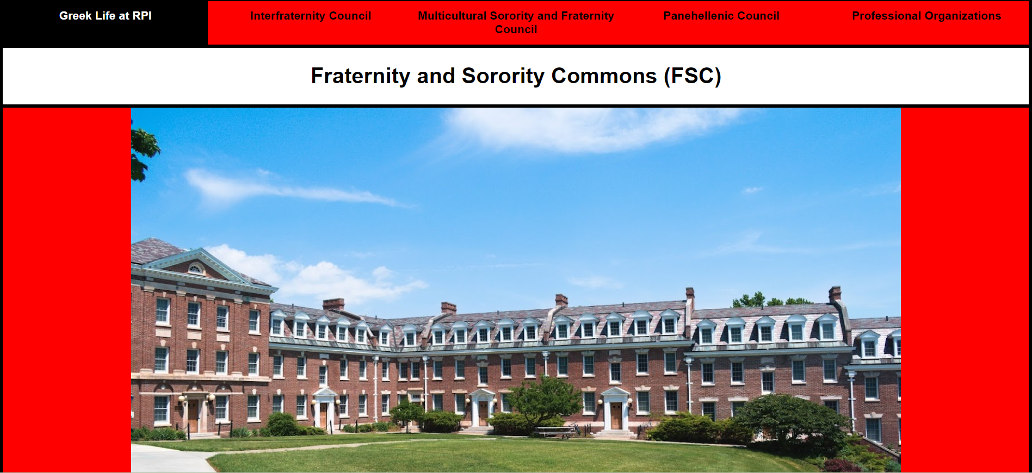
What is our Project?
Why was it made?
What is the FSC Website?
A Central Hub of information on Greek Organizations at RPI
Why make a new FSC Website?
Current FSC website is old, out of touch, and missing a lot of information
Those who run the site take an extremely unreasonable time to make updates to the website that could be crucial for an organization’s campus image
Our Homepage!
Notes:
The Fraternity Sorority Commons, or FSC, is the governing body for all Greek Organizations on campus here at RPI. Within that body are four councils that each govern a smaller set of Greek Organizations. Our website serves to show the entirety of the FSC and its organizations in a single, easy to use location that allows users to learn more about the organizations at RPI.
We decided to make this project because at least 2 of us, as well as our peers, have expressed difficulty in finding information on all the organizations on campus. Currently, there is an FSC website maintained by the FSC advisors, however it is outdated, riddled with typos, and provides little information on organizations as a whole. The site instead focuses on academic reports that only go as recent as 2022, and judicial hearings for each chapter.

Slide 4
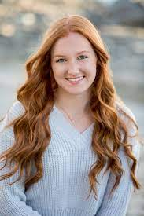
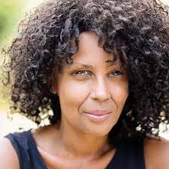
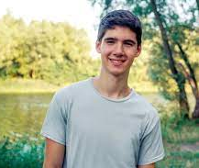
Personas
James (19) is a freshman at RPI who is interested in Greek Life as a way of making connections
Laney (18) is a senior graduating from her local high school. She is eager to join Greek Life when she comes to RPI and wants to learn more.
Debra (46) is the mother of an RPI student. After hearing he wants to join a fraternity, she is hesitant to give the go ahead because of past experience.
Notes:
James (19) is a freshman at RPI who did not make many friends in the first few weeks. He is interested in Greek Life as a way of making connections.
Laney (18) is a senior graduating from her local high school. She plans on attending RPI in the Fall, is eager to join Greek Life and wants to learn more.
Debra (46) is the mother of an RPI student who wants to join a fraternity. She has had a bad experience with Greek Life in the past, and wants to make sure this is a safe choice for him.

Slide 5
Development Strategy
General Steps for Application Development:
Research on Organizations and Councils
Place this information into a JSON file
Use Javascript to dynamically each organization page using the JSON file information
Build landing and council pages
Focus Areas:
Area 1 HTML, CSS, and graphics for page layout and design
Area 3 Pull static data from a data file (JSON)
Javascript
Research
HTML/CSS
JSON
Notes:
The first step of our application development depended on research for each of the greek organizations on the RPI campus and their councils. This was a lengthy process, as we had to navigate through every single headquarters and local chapter website for the 32+ organizations. In addition, we had to locate images of their crests, flags, and houses, which were not always on the website.
Once this was completed, we planned on creating a template for each organization and hardcoding the information into the files. However, we quickly realized it would be more efficient to place the information into a JSON file and have a javascript file dynamically build each organization page. This also makes it much easier to update existing information and add new or returning chapters to campus.
Once these pages were complete, we needed council pages to link users to each organizations page, as well as provide additional information on the council itself.
Since we decided to make such a big change in our development strategy, we also changed our focus area to Areas 1 and 3 from the original choice of Areas 1 and 2.

Slide 6
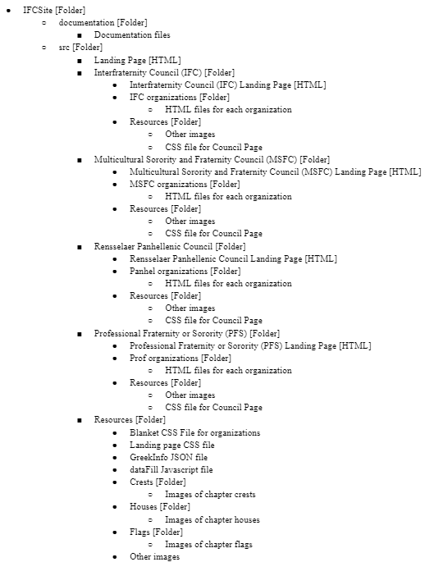
Development Strategy -
Information Architecture
IFC
Panhel
MSFC
Professional Organizations
Notes:
THis is our information architecture, which again due to our changes had a massive overhaul.

Slide 7

Group Dynamics
Landing Page - Quinn
MSFC - Quinn
Alpha Phi Alpha - Quinn
FIA - Quinn
PDPsi - Quinn
Omega Phi Beta - Quinn
Professional - Alex
AOE - Alex
Order of Omega - Alex
RSEi - Alex
APO - Alex
Panhel - Sree Lasya
AGD - Sree Lasya
Pi Phi - Sree Lasya
Alpha Phi - Sree Lasya
IFC - Quinn
Acacia, AXP, AEPi, Asig, Chi Phi, DKE, Delta Phi - Sree Lasya
LXA, FIJI, Ski, Pi Kappa Phi, SAE, Sigma Chi - Alex
Pi Lam, Pikes, Sig Ep, TEP, TKE, Zoo, Zeta Psi - Quinn
Notes:
Here is how we divvied up the work amongst our team. Each of us tackled at least one council as a whole, including its council page and its organizations. However, since the IFC has so many fraternities, we divided the organizations three ways. For each of these assignments, the task was for the individual to not just create the web page for the listed organization or council, but also do any research needed on it.

Slide 8

Features
Map using iframe (inline framing)
Dynamically loaded organization pages with information and colors
Navigation Bar
Connected Website
Easy Usability
Good User Experience
Notes:
Map using iframe is definitely a very important feature of our website and is also very useful because it locates where some of the houses are at RPI. This is important because at RPI many of the fraternities are in different places and it is often confusing where they are located.
Each web page consists of information about a specific house: this includes picture of the house, founding date, motto, house address, website, and instagram. Furthermore, the colors of each web page are different to represent the unique colors associated with the specific house. This was done by dynamically loading the org pages with information and colors using our json file which Alex talked about.
We also have a navigation bar that makes our website easy to use and very connected. Users can just click on what to they want to see and go through the website
Our website always links back to the council pages because of our navigation bar, so when users click on one of the houses to view the page the nav bar is always available and users can click to go back to council pages. This is to ensure that our website never reaches a dead end and we keep the website connected.
To reiterate, our website is very user friendly and has a good user experience. Our target is RPI students who are interested in greek life and want to learn about what RPI has to offer.

Slide 9


Demonstration of Website
Notes:
Walk through the website and show the features and go through it for around one minute (go through each council page and click through atleast one house page)

Slide 10
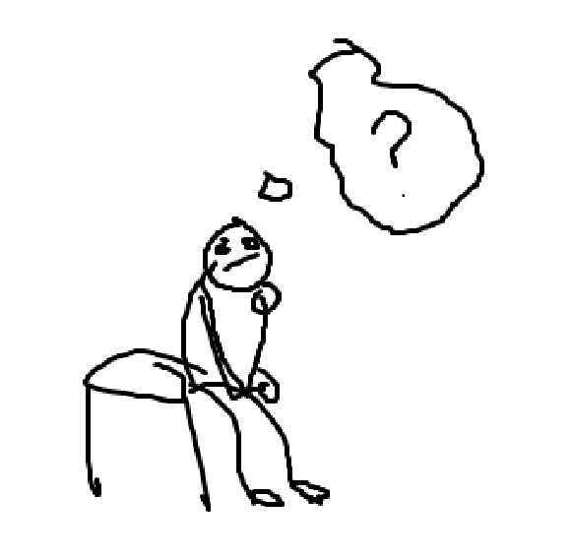
Reflection
What Didn’t Work (Changes We Made):
Dynamically loading the individual organization pages
Our overall IA
What Did Work
Page Layout (Navbar/other information)
Dividing work evenly amongst the group
Notes:
Dynamically loading the individual organization pages: Changed from writing out each individual page to loading the page data dynamically, helped to save time in development
Our overall IA: Restructured our council folders for organization and development purposes
Page Layout: We did not have to make any changes to the layout of our pages as the information followed a template for each page
Dividing Work Evenly: Each person was able to carry their own weight as the project workload was not extremely strenuous due to the dynamically loading nature of the pages

Slide 11
Future of the application
Search:
Philanthropy
Org 1 - $xxx raised towards xxx foundation
Org 2 - $xxx raised towards xxx foundation
Org 3 - $xxx raised towards xxx foundation
Org 4 - $xxx raised towards xxx foundation
Org 5 - $xxx raised towards xxx foundation
Org 6 - $xxx raised towards xxx foundation
Org 7 - $xxx raised towards xxx foundation
Notes:
We plan to share this application with the student executives of the Fraternity Sorority Commons so that the website stays useful and up to date. Handing it off the faculty advisors of the FSC would not be useful as they likely would spend equally as much time updating this website as the existing FSC website, which isn't much at all.
Future versions of this application could include adding extra interactions to the webpages, new information, or simply adding new features. One feature which we wanted to add was a search feature that would find organizations based on certain tags. This way users of the site could find the organizations they are looking even faster than in our current version. An example of this could be a search query of “Philanthropy”, and the chapters that raised the money in a given year would show up as results.

Slide 12
Sources
Computer Image
Live Demo Image
Features Image
FSC Logo Image
Group Puzzle Image
Thank You Image
Agenda Image

Slide 13

Any Questions?

